Slide 1
Campus To Corporate by Sharma Nisha

Slide 2
What is Campus to Corporate?
Campus to corporate is nothing but a smooth transition or journey of student from academic life to professional life.
Academic learning provides foundational knowledge ,theory of any subject like-how to code ,solve mathematical concepts.
Real world application is where we can get the practical knowledge in practical situations like building project, software, handling clients

Slide 3
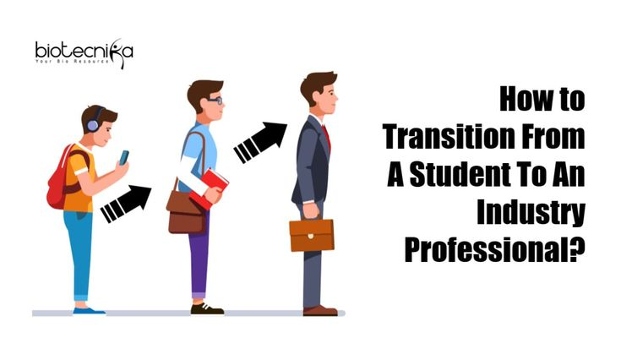
Transition
Transition from
student life
to
professional world

Slide 4

Campus life Vs Corporate life

Slide 5
Campus life Vs Corporate life
Flexible schedule vs Fixed work hours
In college, we have more freedom with our time but in a job, we follow fixed office hours and must be punctual.
Guided by Faculty vs Self-Driven Tasks
In campus, teachers provide step by step guidance to the student but in corporate, we are expected to work independently.
Focus on Grades vs Focus on Results
In campus, marks matter a lot, but in professional our output is matter based on how much input give to the project.
Casual vs Formal Communication
Campus talks are informal with faculty and friend, but at professional we have to talk polite.

Slide 6
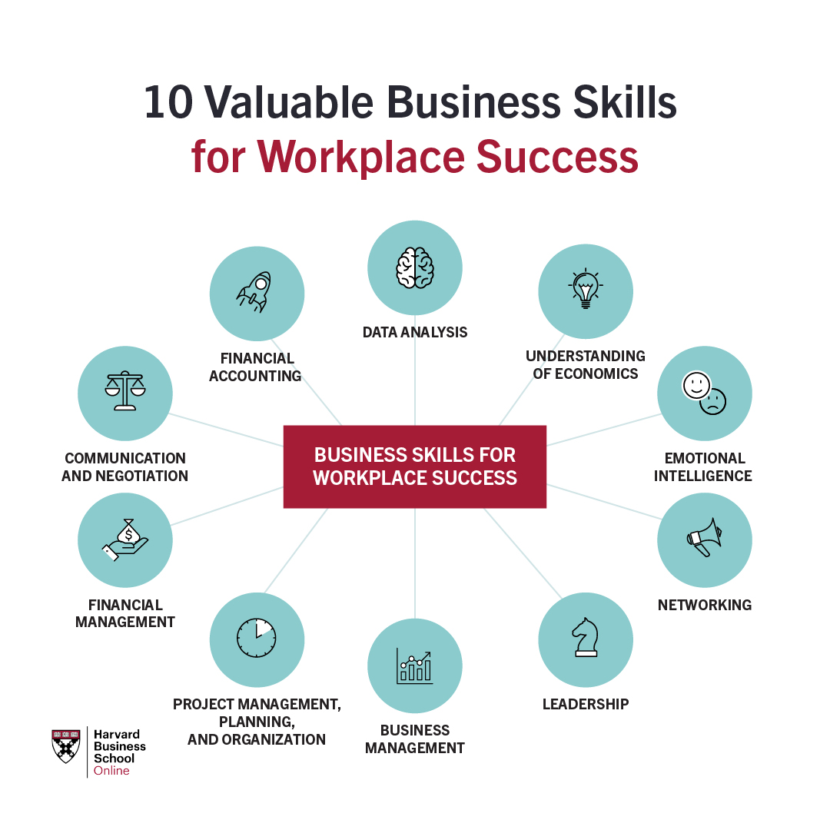
Skills required for corporate life
-Effective Communication
- Time Management and Punctuality
- Problem Solving & Critical Thinking
- Teamwork and Collaboration
- Adaptability and Continuous Learning

Slide 7
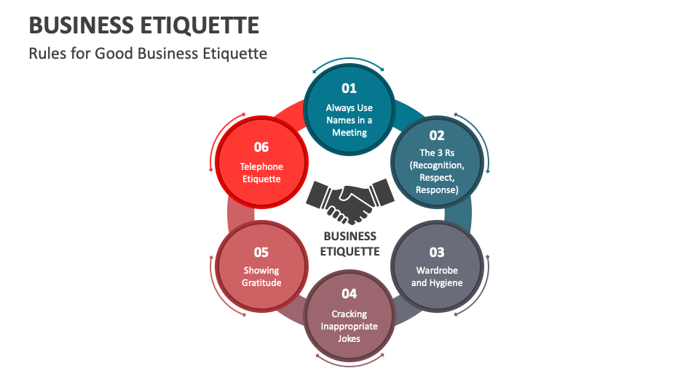
Professional etiquette
Professional etiquette is the set of rules and behaviors that show respect, politeness, and professionalism in the workplace. It helps you create a good impression and build strong working relationships.

Slide 8
Conclusion
Campus to corporate is a key turning point in a student’s life.
It makes the shift from academic learning to real-world application.
Embracing workplace values like punctuality, teamwork, and effective communication is essential.
With the right mindset and preparation, students can smoothly transition into confident, responsible professionals.

Slide 9
Thank you

